Slide 1

Data Structures Using C++ 2E
Chapter 10
Sorting Algorithms
Updated December 2020

Slide 2
Objectives
Learn the various sorting algorithms
Explore how to implement selection sort, insertion sort, Shellsort, quicksort, mergesort, and heapsort
Discover how the sorting algorithms discussed in this chapter perform
Learn how priority queues are implemented
Data Structures Using C++ 2E

Slide 3
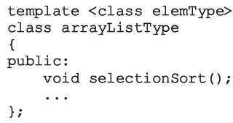
Sorting Algorithms
Several types in the literature
  Discussion includes most common algorithms
Analysis
  Provides a comparison of algorithm performance
Functions implementing sorting algorithms
  Included as public members of related class
Data Structures Using C++ 2E

Slide 4
BubbleSort
Pass through the array elements several times. In each pass, compare the element with its successor, if out of order, interchange.
e.g: Sort the below numbers using bubblesort algorithm, list the number after pass 2.
36 24 10 6 12
24 10 6 12 36 end of pass 1
10 6 12 24 36 end of pass 2
6 10 12 24 36 end of pass 3
Data Structures Using C++ 2E

Slide 5
Selection Sort: Array-Based Lists
List sorted by selecting elements in the list
  Select elements one at a time
  Move elements to their proper positions
Selection sort operation
  Find location of the smallest element in unsorted list portion
    Move it to top of unsorted portion of the list
  First time: locate smallest item in the entire list
  Second time: locate smallest item in the list starting from the second element in the list, and so on
Data Structures Using C++ 2E

Slide 6
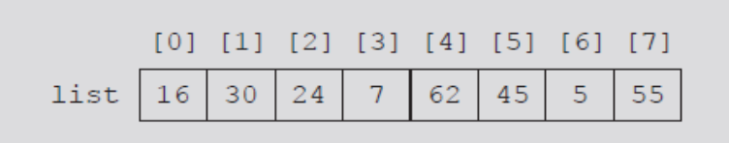
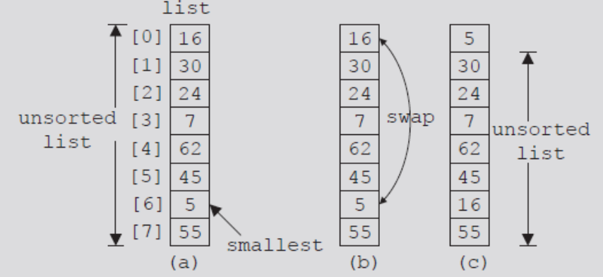
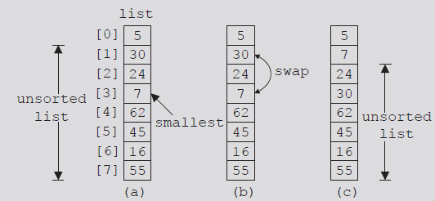
FIGURE 10-1 List of 8 elements
FIGURE 10-2 Elements of list during the first iteration
FIGURE 10-3 Elements of list during the second iteration
Data Structures Using C++ 2E

Slide 7
Selection Sort: Array-Based Lists (cont’d.)
Selection sort steps
  In the unsorted portion of the list
    Find location of smallest element
    Move smallest element to beginning of the unsorted list
Data Structures Using C++ 2E

Slide 8
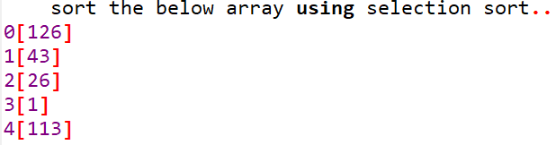
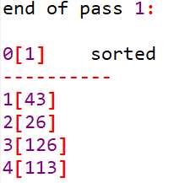
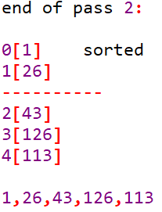
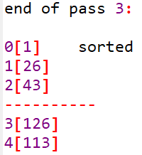
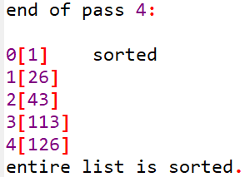
Selection Sort Example
Data Structures Using C++ 2E

Slide 9
Analysis: Selection Sort
Search algorithms
  Concerned with number of key (item) comparisons
Sorting algorithms
  Concerned with number of key comparisons and number of data movements
Analysis of selection sort
    Number of key comparisons of O(n²)
Data Structures Using C++ 2E

Slide 10
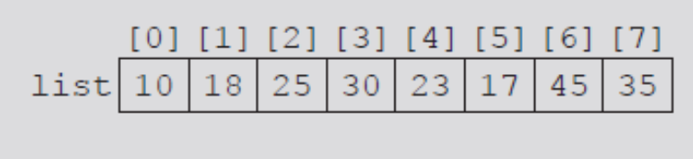
Insertion Sort: Array-Based Lists
Attempts to improve high selection sort key comparisons
Sorts list by moving each element to its proper place
Given list of length eight
FIGURE 10-4 list
Data Structures Using C++ 2E

Slide 11
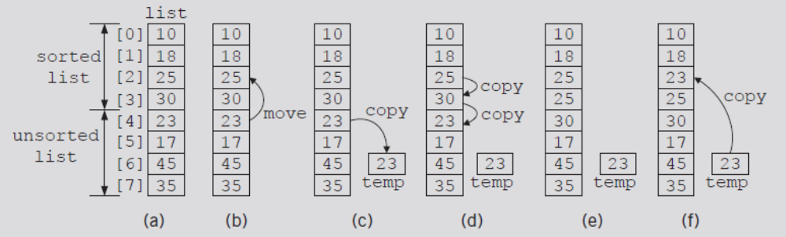
Insertion Sort: Array-Based Lists (cont’d.)
Elements list[0], list[1], list[2], list[3] in order
Consider element list[4]
  First element of unsorted list
FIGURE 10-5 list elements while moving list[4] to its proper place
Data Structures Using C++ 2E

Slide 12
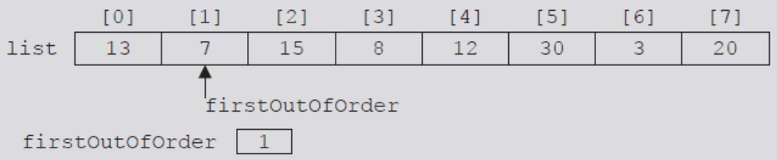
Insertion Sort: Array-Based Lists (cont’d.)
length = 8
Initialize firstOutOfOrder to one
FIGURE 10-6 firstOutOfOrder = 1
Data Structures Using C++ 2E

Slide 13
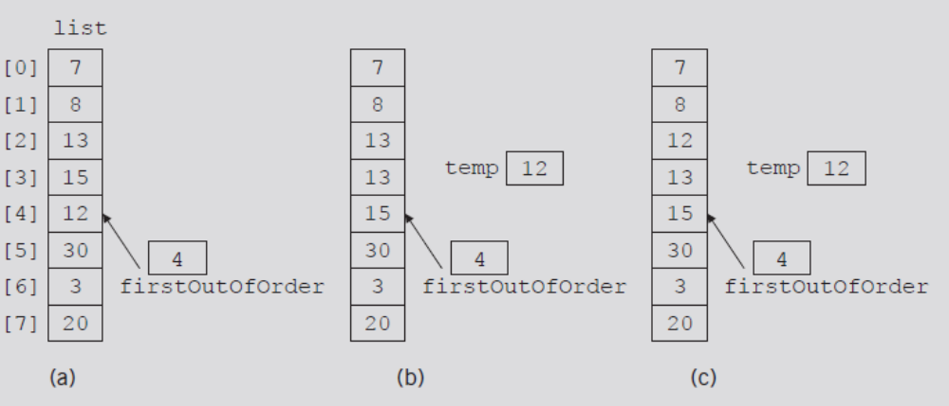
Insertion Sort: Array-Based Lists (cont’d.)
Suppose list given in Figure 10-8(a)
  Walk through code
FIGURE 10-8 list elements while moving list[4] to its proper place
Data Structures Using C++ 2E

Slide 14
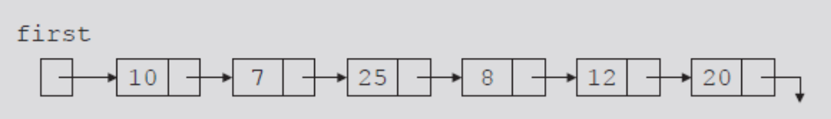
Insertion Sort: Linked List-Based Lists
If list stored in an array
  Traverse list in either direction using index variable
If list stored in a linked list
  Traverse list in only one direction
    Starting at first node: links only in one direction
FIGURE 10-10 Linked list
Data Structures Using C++ 2E

Slide 15
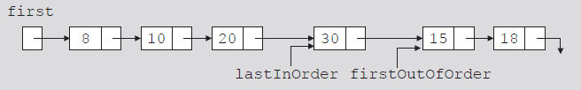
Insertion Sort: Linked List-Based Lists (cont’d.)
firstOutOfOrder
  Pointer to node to be moved to its proper location
lastInOrder
  Pointer to last node of the sorted portion of the list
FIGURE 10-11 Linked list and pointers lastInOrder
and firstOutOfOrder
Data Structures Using C++ 2E

Slide 16
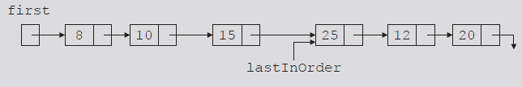
Insertion Sort: Linked List-Based Lists (cont’d.)
Case 1
  firstOutOfOrder->info less than first->info
    Node firstOutOfOrder moved before first
    Adjust necessary links
FIGURE 10-13 Linked list after moving the node with info 8 to the beginning
Data Structures Using C++ 2E

Slide 17
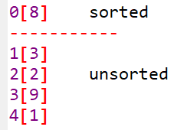
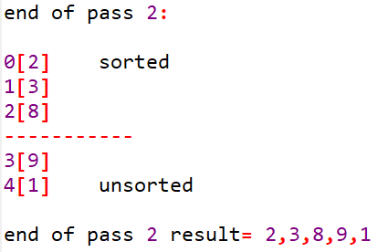
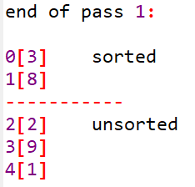
Insertion Sort Example
Data Structures Using C++ 2E

Slide 18
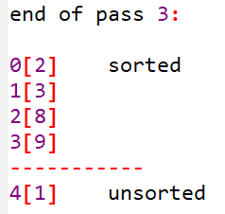
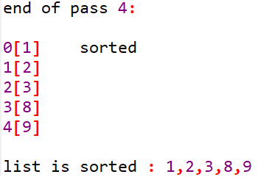
InsertionSort Example Cont.
Data Structures Using C++ 2E

Slide 19
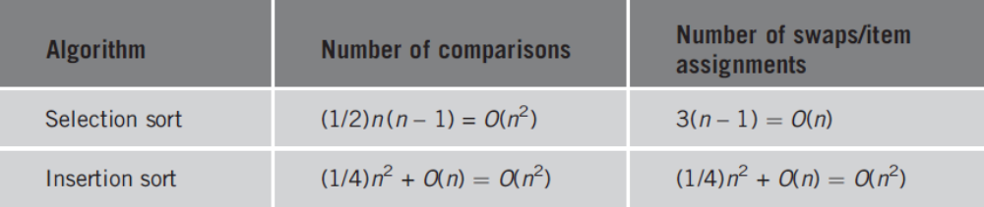
Analysis: Insertion Sort
TABLE 10-1 Average-case behavior of the selection sort and insertion sort for a list of length n
Data Structures Using C++ 2E

Slide 20
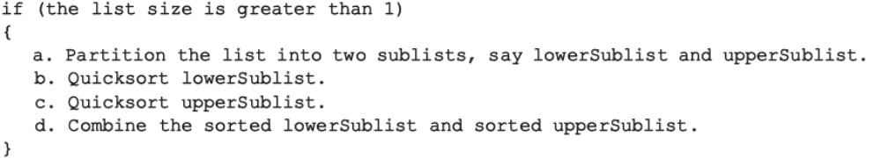
Quicksort: Array-Based Lists
Uses the divide-and-conquer technique to sort a list
  List partitioned into two sublists
    Two sublists sorted and combined into one list
    Combined list then sorted using quicksort (recursion)
Trivial to combine sorted lowerSublist and upperSublist
All sorting work done in partitioning the list
Data Structures Using C++ 2E

Slide 21
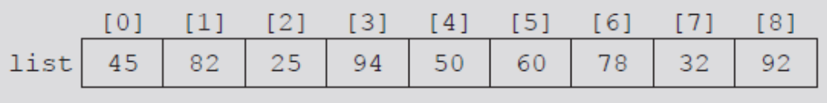

Quicksort: Array-Based Lists (cont’d.)
Pivot divides list into two sublists
  lowerSublist: elements smaller than pivot
  upperSublist: elements greater than pivot
Choosing the pivot
  lowerSublist and upperSublist nearly equal
FIGURE 10-21 List before the partition
FIGURE 10-22 List after the partition
Data Structures Using C++ 2E

Slide 22
Quicksort: Array-Based Lists (cont’d.)
Partition algorithm
  Determine pivot; swap pivot with first list element
    Suppose index smallIndex points to last element smaller than pivot. smallIndex initialized to first list element
  For the remaining list elements (starting at second element): If current element smaller than pivot
    Increment smallIndex
    Swap current element with array element pointed to by smallIndex
  Swap first element (pivot) with array element pointed to by smallIndex
Data Structures Using C++ 2E

Slide 23
Quicksort Example
Choose an element (first, middle, last) as pivot and split the array into two where elements to the left of the pivot are smaller or equal to the pivot, and elements to the right are greater than the pivot. Then sort the left and right subarrays.
Example:
Sort the below values using quicksort algorithm, choose the first element as pivot.
26 33 35 29 19 12 22
Data Structures Using C++ 2E

Slide 24
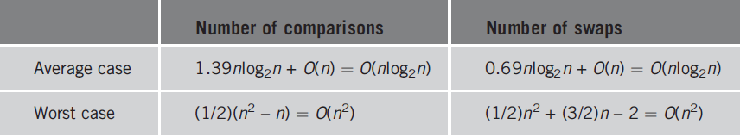
Analysis: Quicksort
TABLE 10-2 Analysis of quicksort for a list of length n
Data Structures Using C++ 2E

Slide 25
Mergesort: Linked List-Based Lists
Quicksort
  Average-case behavior: O(nlog₂n)
  Worst-case behavior: O(n²)
Mergesort behavior: always O(nlog₂n)
  Uses divide-and-conquer technique to sort a list
  Partitions list into two sublists
    Sorts sublists
    Combines sorted sublists into one sorted list
Difference between mergesort and quicksort
  How list is partitioned
Data Structures Using C++ 2E

Slide 26
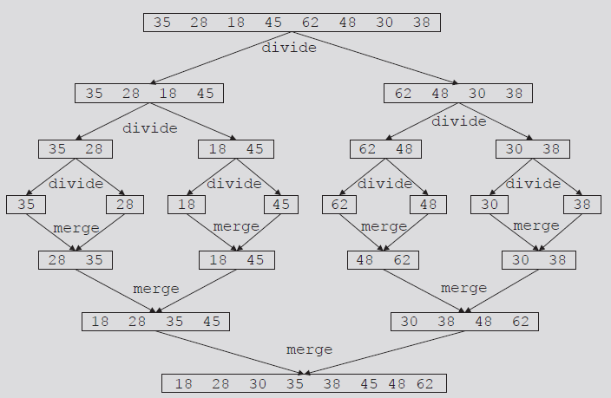
Mergesort: Linked List-Based Lists (cont’d.)
FIGURE 10-32 Mergesort algorithm
Data Structures Using C++ 2E

Slide 27
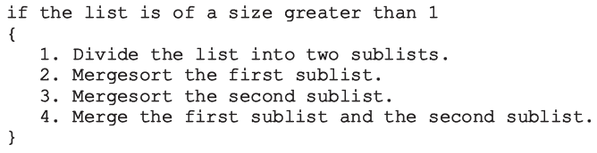
Mergesort: Linked List-Based Lists (cont’d.)
Most sorting work done in merging sorted sublists
General algorithm for mergesort
Data Structures Using C++ 2E

Slide 28
Divide
To divide list into two sublists
  Need to find middle node
  Use two pointers: middle and current
    Advance middle by one node, advance current by one node
    current becomes NULL; middle points to last node
  Divide list into two sublists
    Using the link of middle: assign pointer to node following middle
    Set link of middle to NULL
See function divideList on page 561
Data Structures Using C++ 2E

Slide 29
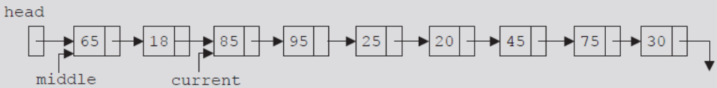
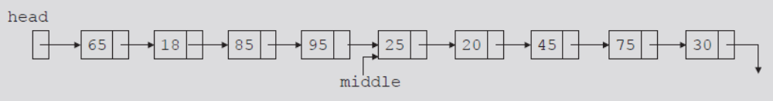
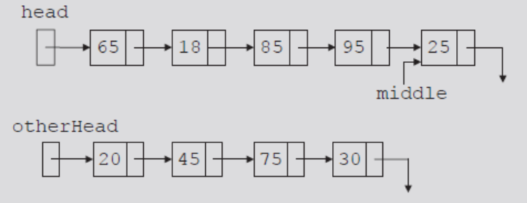
FIGURE 10-33 Unsorted linked list
FIGURE 10-34 middle and current before traversing the list
FIGURE 10-35 middle after traversing the list
FIGURE 10-36 List after dividing it into two lists
Data Structures Using C++ 2E

Slide 30
Merge
Once sublists sorted
  Next step: merge the sorted sublists
Merge process
  Compare elements of the sublists
  Adjust references of nodes with smaller info
See code on page 564 and 565
Data Structures Using C++ 2E

Slide 31
Merge Sort Example
[12] [35] [52] [34] [11] [85] [78] [42]
Data Structures Using C++ 2E

Slide 32
Analysis: Mergesort
Maximum number of comparisons made by mergesort: O(n log₂n)
If W(n) denotes number of key comparisons
  Worst case to sort L: W(n) = O(n log₂n)
Let A(n) denote number of key comparisons in the average case
  Average number of comparisons for mergesort
  If n is a power of 2
    A(n) = n log₂n - 1.25n = O(n log₂n)
Data Structures Using C++ 2E

